Slide 1
NYSE Analysis With MySQL
Ethan Graham, Scott Gozdzialski, Huynh Vu
Graduate Students Master of Data Science
Southern Methodist University
Dallas, Texas

Slide 2
NYSE Securities Analysis With MySQL
Initial plan: https://cran.rstudio.com/web/packages/stocks/index.html
Utilities, but no actual data
Better Plan: https://www.kaggle.com/benjibb/lstm-stock-prediction-20170507/data
NYSE DATA FROM 2010-2016

Slide 3
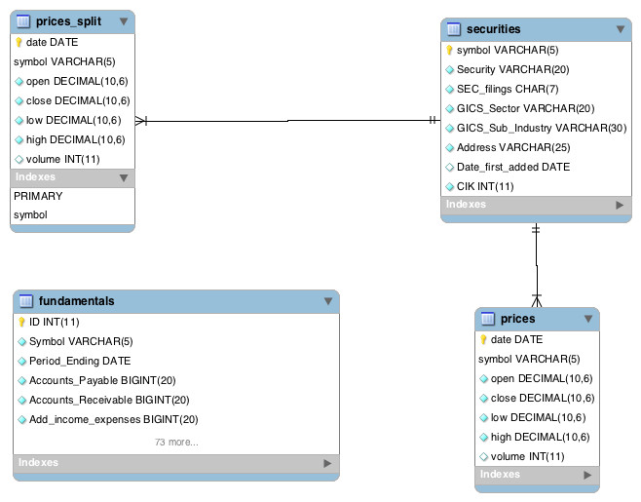
MYSQL DATABASE

